Slide 1

Dynamics 365 for Talent: Onboard

Slide 2

The challenge
Our current onboarding experience is delaying the impact of new hires
2

Slide 3
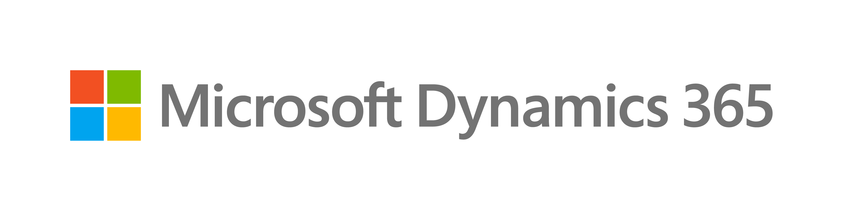
Our critical onboarding issues
Lengthy pre-boarding process: <enter avg days>
Process is inconsistent and highly manual
Paperwork and background checks must be compliant
New hires lack resources and are not set up in the system properly
Long time to productivity:
New hires lack clarity in roles and responsibilities
Training resources are difficult to find
Managers lack tools to set new hires up for success
High employee turnover costs:
<enter number>% of employees leave within 90 days
<enter number>% of employees leave within a year
This is despite our heavy investment in engagement and retention programs
Result: Frustrated manager and unengaged hire
Result: Team does not deliver expected business results
Result: Impacts our employer brand and ability to attract new talent
3

Slide 4

Our industry also presents talent challenges
<enter industry> faces unique talent issues:
67% of employers believe retention rates would be higher if candidates had a clearer picture of what to expect about working at the company before taking the job*
<insert appendix proof point two>
<insert appendix proof point three>
<insert appendix proof point four>
The result: actively disengaged employees cost the US $506 billion in lost productivity annually.
*Harris Interactive Survey for Glassdoor, 2014
4

Slide 5
The solution
Modernize our onboarding experience to set up new team members for success
5

Slide 6
How we can set up new team members for success
Five steps to effective onboarding:
1
2
3
4
5
Welcome
Standardize a role-based process that begins before the start date
Educate
Provide hires with onboarding guides that map a comprehensive path to success
Connect
Help new employees make cross-disciplinary connections quickly
Immerse
Give employees on-demand access to what they need to be efficient and effective
Insights
Enable process improvements by tracking what’s working well and why
The result: accelerated time to productivity and impact.
6

Slide 7




Getting the right people involved
Enable our team with the right processes and technology:
Human Resources
Hiring Manager
Key Stakeholders
Team Members
Redesign the onboarding experience and build best practice templates
Include company culture, vision, and mission in all strategy documents.
Personalize templates with team priorities and growth plans for each role
Provide team-specific onboarding tasks required of each new employee
Get connected early by offering success tips for new team members

Slide 8
Dynamics 365 for Talent: Onboard
8

Slide 9

Empower new hires with a modern onboarding experience
A modern onboarding experience creates added value by:
Streamlining: Optimize the processes we need and eliminate the ones we don’t
Welcoming: Help new hires feel immediately at home
Motivating: Ignite our employees’ fire and get them engaged in being part of the <insert company> name
The result: cost-effective onboarding with a near-immediate return on investment.
9

Slide 10
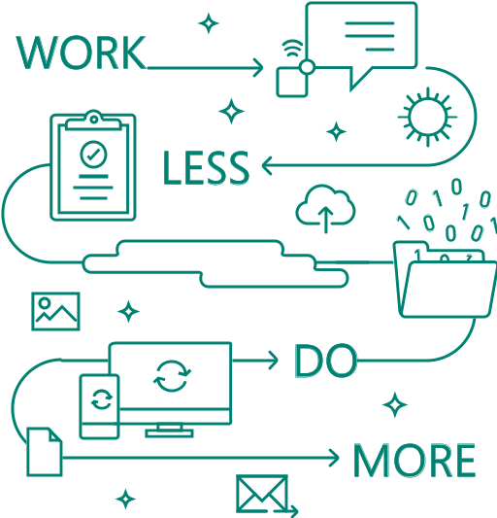
Dynamics 365 for Talent: Onboard minimizes disruption
Create a more efficient hiring process with:
Swift implementation and ability to scale
Universal cloud-based access
Intuitive, mobile user experience
Flexibility and extensibility
Predictive insights and analytics
10

Slide 11

Onboard in action: Chemonics case study
Chemonics employs 5,000 talented development professionals across roughly 140 global projects. To accelerate new project office set up, find the best people, and help them be productive as quickly as possible, Chemonics uses Microsoft Dynamics 365 for Talent.
Watch Video >
11

Slide 12
High-level rollout plan
Day <#> to Day <#>
<insert high-level milestone>
<insert high-level milestone>
<insert high-level milestone>
Day <#> to Day <#>
<insert high-level milestone>
<insert high-level milestone>
<insert high-level milestone>
Day <#> to Day <#>
<insert high-level milestone>
<insert high-level milestone>
<insert high-level milestone>
Day <#> to Day <#>
<insert high-level milestone>
<insert high-level milestone>
<insert high-level milestone>
12

Slide 13

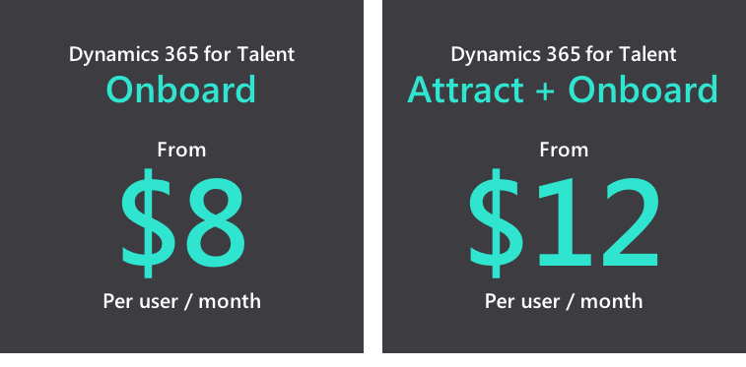
Dynamics 365 for Talent: Pricing
We can improve our current Onboarding experience while still keeping what’s already working. Total users needed: <insert number>
<Insert Company>’s cost for
Attract + Onboard
Total monthly cost
<$>
$12 per user / <#> users
13

Slide 14
Appendix
14

Slide 15
Our industry also presents talent challenges (examples) Industry-specific bullet points: financial services
The financial services industry faces unique talent issues:
Globalization and an aging workforce are making the talent landscape increasingly competitive:
According to 70% of financial services CEOs, limited availability of skills & global competition are a bigger threat than competition from new market entrants and disruptive shifts in both consumer spending and behavior.*
A need for digital transformation means companies have to develop an adaptive, diverse, and digitally savvy workforce.
A serious talent shortage, especially in innovation and growth roles, means R&D and leadership suffer the most.
Financial HR execs feel the impact of digital transformation and need to focus on talent acquisition, performance and rewards, and development.
Well-equipped employees move on to greener pastures if not rewarded adequately, meaning compensation programs need to adapt.
*PwC’s 19th Annual Global CEO Survey: Key talent findings in the financial services
15

Slide 16
Our industry also presents talent challenges (examples) Industry-specific bullet points: financial services (cont.)
The financial services industry faces unique talent issues:
Globalization and an aging workforce are making the talent landscape increasingly competitive:
Scarcity of talent means HR must redefine critical competencies and create specific opportunities to attract, develop, reward, and retain the skillsets it needs the most.
According to Deloitte, private equity and hedge funds struggle to retain employees, since fewer funds with positive returns can lower compensation.
Consolidation in the banking and securities sector creates both a retention challenge and the need to build a leadership succession plan.
The insurance sector, which is having difficulty attracting young talent to the traditional insurance distribution models, is facing a significant skill shortage.
16

Slide 17
Our industry also presents talent challenges (examples) Industry-specific bullet points: public sector
The public sector faces unique talent issues:
Globalization, an aging workforce, and millennials’ entry to the talent pool are making the landscape increasingly competitive:
How do we foster a workforce for the future, made up of generations of educated, skilled employees?
Globalization and both social and mobile technology are changing the workplace; many US employers—public and private—are scrambling to stay ahead of the coming talent shortage.
Mobile technology and digital transformation challenge conventional wisdom that the public sector does not need innovation.
Talent scarcity means companies are more likely to rely on technological innovation to compensate for shortfalls in skilled personnel and productivity.
17

Slide 18
Our industry also presents talent challenges (examples) Industry-specific bullet points: public sector (cont.)
The public sector faces unique talent issues:
The need to recruit for highly specialized skillsets means we have to adapt our culture to younger workers’ needs with a more dynamic work environment.
The attrition rates of an aging workplace create a huge burden in replacing leadership roles.
Succession plans need to be formulated to prepare leaders to move quickly into new roles and become enablers of change.
Future leaders will need to acquire advanced skills, competencies, and behaviors to meet the full range of challenges ahead.
18

Slide 19
Our industry also presents talent challenges (examples) Industry-specific bullet points: public sector (cont.)
The public sector faces unique talent issues:
We need a holistic talent strategy to improve hiring quality, boost productivity, increase efficiency, mitigate compliance risk, and reduce costs.
The diffusion of control created by increasing information sharing and transparency can inhibit workplace productivity.
The need for accountability is greater than ever, and public sector HR professionals are actively reviewing which programs will optimize talent development and productivity.
New directions in government, born of economic disruption and change of administration, require the public sector to assume new roles and responsibilities.
Empowering the workforce in new ways is critical to enhancing engagement, productivity, and performance.
19

Slide 20
Our industry also presents talent challenges (examples) Industry-specific bullet points: healthcare
The healthcare industry faces unique talent issues:
The sheer dearth of candidates, regardless of qualification, is making the talent landscape increasingly competitive:
Niche specialties are especially susceptible to talent scarcity.
Hiring for specialized roles from only a handful of qualified candidates leaves little room for company leverage.
Benefits, compensation, and relocation programs require a specialized tiered structure to be effective and productive.
Development is key—workers want to fully develop and utilize their skills, capabilities, and competencies.
Employee engagement and interaction are key to creating a productive culture that can endure periods of rapid growth or transition.
Employee engagement strategies need to incorporate social and professional development opportunities that reflect a corporate culture of interaction, learning, and team building.
Continuously changing regulations and compliance challenges mean technology solutions have to be multi-functional enough to address these issues and customize when needed.
20

Slide 21
Our industry also presents talent challenges (examples) Industry-specific bullet points: manufacturing
The manufacturing industry faces unique talent issues:
Globalization and the need to manage labor relations are making the talent landscape increasingly competitive:
HR needs to expand its focus beyond employee and labor relations to developing a positive and engaging digital workplace that offers the right compensation and benefit packages to both union and non-union staff.
Talent competition is exacerbated by prevailing perceptions among younger demographics that there is a lack of innovation in manufacturing careers.
Widespread image problems, despite our industry’s growth and potential, mean we are not a top choice for talented professionals.
A focus on short-term commitment and rewards underscores perceptions of manufacturing as a stagnant industry.
A blended workforce made up of full-time, temporary, contract, and seasonal employees presents ongoing challenges.
21

Slide 22
Our industry also presents talent challenges (examples) Industry-specific bullet points: retail
The retail industry faces unique talent issues:
Filling seasonal roles, preventing employee theft, balancing workforce diversity, managing shift work, and high turn-over rates are all making the talent landscape increasingly competitive:
In-demand talents allow businesses to seek out fresh sources of value and capitalize on opportunities that competitors may miss or be unable to exploit.
Business must evolve their workforces to reflect the changing nature of the marketplace.
Retail organizations need to attract, retain, and excite the star talent required to execute a winning business strategy.
Organizations need to strengthen their employer brands to succeed in the talent marketplace.
Succession pipelines are more important than ever.
22

Slide 23
© Copyright Microsoft Corporation. All rights reserved.

